Slide 1
Hadoop YARN

Slide 2
YARN stands for “Yet Another Resource Negotiator“. It was introduced in Hadoop 2.0 to remove the bottleneck on Job Tracker which was present in Hadoop 1.0. YARN was described as a “Redesigned Resource Manager” at the time of its launching, but it has now evolved to be known as large-scale distributed operating system used for Big Data processing

Slide 3
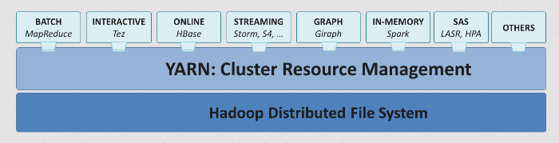

Slide 4
The main components of YARN architecture include:
Client
Resource Manager
Scheduler
Application Manager
Node Manager
Application Master
Container

Slide 5
Resource Manager
It is the master daemon of YARN and is responsible for resource assignment and management among all the applications.
Whenever it receives a processing request, it forwards it to the corresponding node manager and allocates resources for the completion of the request accordingly.
It has two major components:
Scheduler:
It performs scheduling based on the allocated application and available resources.
It is a pure scheduler, means it does not perform other tasks such as monitoring or tracking and does not guarantee a restart if a task fails.
The YARN scheduler supports plugins such as Capacity Scheduler and Fair Scheduler to partition the cluster resources.
Application manager:
It is responsible for accepting the application and negotiating the first container from the resource manager.
It also restarts the Application Manager container if a task fails.

Slide 6
Node Manager
It take care of individual node on Hadoop cluster and manages application and workflow and that particular node.
Its primary job is to keep-up with the Node Manager.
It monitors resource usage, performs log management and also kills a container based on directions from the resource manager.
It is also responsible for creating the container process and start it on the request of Application master.

Slide 7
Application Master
An application is a single job submitted to a framework. The application manager is responsible for negotiating resources with the resource manager, tracking the status and monitoring progress of a single application.
The application master requests the container from the node manager by sending a Container Launch Context(CLC) which includes everything an application needs to run.
Once the application is started, it sends the health report to the resource manager from time-to-time.

Slide 8
Container
It is a collection of physical resources such as RAM, CPU cores and disk on a single node.
The containers are invoked by Container Launch Context(CLC) which is a record that contains information such as environment variables, security tokens, dependencies etc.

Slide 9
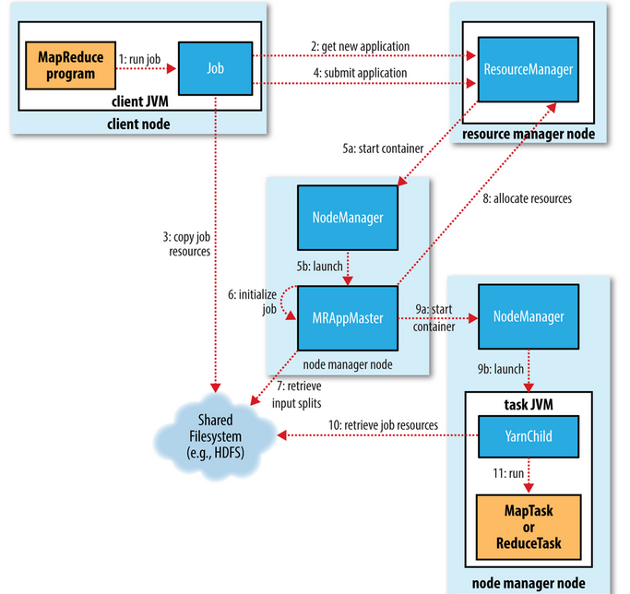
How Hadoop runs Map reduce application

Slide 10
The benefits to using YARN
Scalability – YARN can run on larger clusters than MapReduce 1. MapReduce 1 hits scalability bottlenecks in the region of 4,000 nodes and 40,000 tasks, stemming from the fact that the jobtracker has to manage both jobs and tasks. YARN overcomes these limitations by virtue of its split resource manager/application master architecture it is designed to scale up to 10,000 nodes and 100,000 tasks.In contrast to the jobtracker, each instance of an application—here, a MapReduce job—has a dedicated application master, which runs for the duration of the application.

Slide 11
Availability
Same as HA in HDFS

Slide 12
Multitenancy
In some ways, the biggest benefit of YARN is that it opens up Hadoop to other types of distributed application beyond MapReduce. MapReduce is just one YARN application among many.

Slide 13
Scheduling in Yarn
FIFO
Yarn places applications in a queue and runs them in the order of submission (first in, first out).
Requests for the first application in the queue are allocated first and once its requests have been satisfied, the next application in the queue is served, and so on.
This scheduler is simple to understand and not needing any configuration, but it’s not suitable for shared clusters. Large applications will use all the resources in a cluster, so each application has to wait its turn

Slide 14
Capacity Scheduler
Here a separate dedicated queue allows the small job to start as soon as it is submitted, although this is at the cost of overall cluster utilization since the queue capacity is reserved for jobs in that queue. This means that the large job finishes later than when using the FIFO Scheduler.
The Capacity Scheduler allows sharing of a Hadoop cluster along organizational lines, whereby each organization is allocated a certain capacity of the overall cluster.
Each organization is set up with a dedicated queue that is configured to use a given fraction of the cluster capacity.

Slide 15
Queues may be further divided in hierarchical fashion, allowing each organization to share its cluster allowance between different groups of users within the organization.
Within a queue, applications are scheduled using FIFO scheduling. If there are idle resources available, then the Capacity Scheduler may allocate the spare resources to jobs in the queue, even if that causes the queue’s capacity to be exceeded. This behavior is known as queue elasticity.

Slide 16
Example
Example: A company might allocate 50% of cluster resources to the data analysis team, 30% to the research team, and 20% to the IT team. The Capacity Scheduler ensures that each team has access to its allocated resources.

Slide 17
Fair Scheduler
Here there is no need to reserve a set amount of capacity, since it will dynamically balance resources between all running jobs. Just after the first (large) job starts, it is the only job running, so it gets all the resources in the cluster.
When the second (small) job starts, it is allocated half of the cluster resources so that each job is using its fair share of resources.
Here Scheduler attempts to allocate resources so that all running applications get the same share of resources.

Slide 18
To understand how resources are shared between queues, imagine two users A and B, each with their own queue.
A starts a job, and it is allocated all the resources available since there is no demand from B. Then B starts a job while A’s job is still running, and after a while each job is using half of the resources .
Now if B starts a second job while the other jobs are still running, it will share its resources with B’s other job, so each of B’s jobs will have one-fourth of the resources, while A’s will continue to have half.
The result is that resources are shared fairly between users

Slide 19
Example
Example: If there are three jobs (A, B, and C), each job will get roughly one-third of the cluster resources, regardless of the order in which they were submitted. If job A finishes, the remaining two jobs will split the resources evenly.

Slide 20
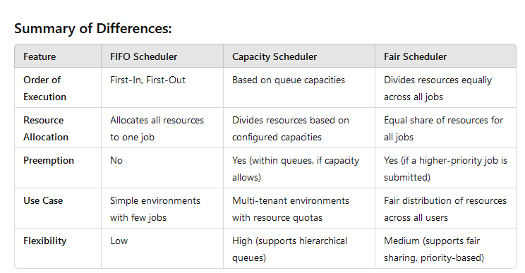

Slide 21
When to Use Which Scheduler?
FIFO Scheduler: Use it for simple environments where job execution order is important, and there aren’t too many users or long jobs.
Capacity Scheduler: Ideal for multi-tenant environments where multiple users or departments share the same cluster and each group has different resource requirements.
Fair Scheduler: Suitable for environments with a mix of short and long jobs, where fairness and efficient resource sharing among all jobs are crucial.

Slide 22
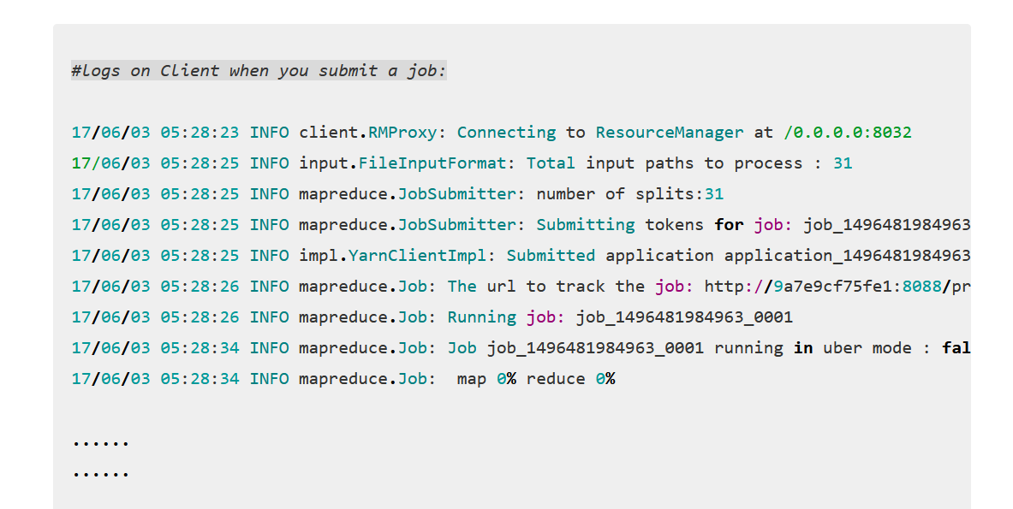
Practically…..

Slide 23
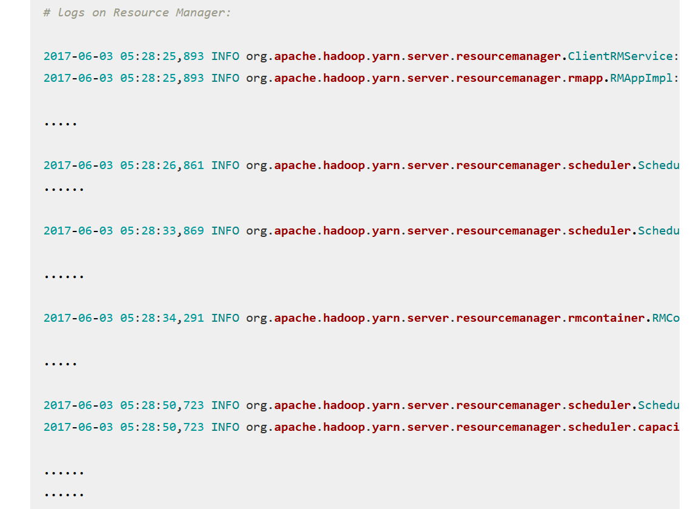

Slide 24
Details of logs :
http://geekdirt.com/blog/introduction-and-working-of-yarn/

Slide 25
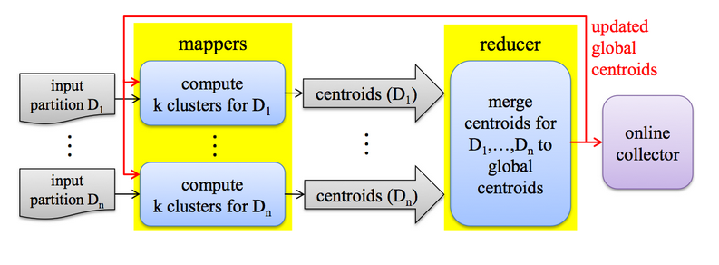
K-Means Clustering

Slide 26
In the map step
Read the cluster centers into memory from a sequencefile
Iterate over each cluster center for each input key/value pair.
Measure the distances and save the nearest center which has the lowest distance to the vector
Write the clustercenter with its vector to the filesystem.
In the reduce step (we get associated vectors for each center)
Iterate over each value vector and calculate the average vector. (Sum each vector and devide each part by the number of vectors we received).
This is the new center, save it into a SequenceFile.
Check the convergence between the clustercenter that is stored in the key object and the new center.
If it they are not equal, increment an update counter
Run this whole thing until nothing was updated anymore.

Slide 27
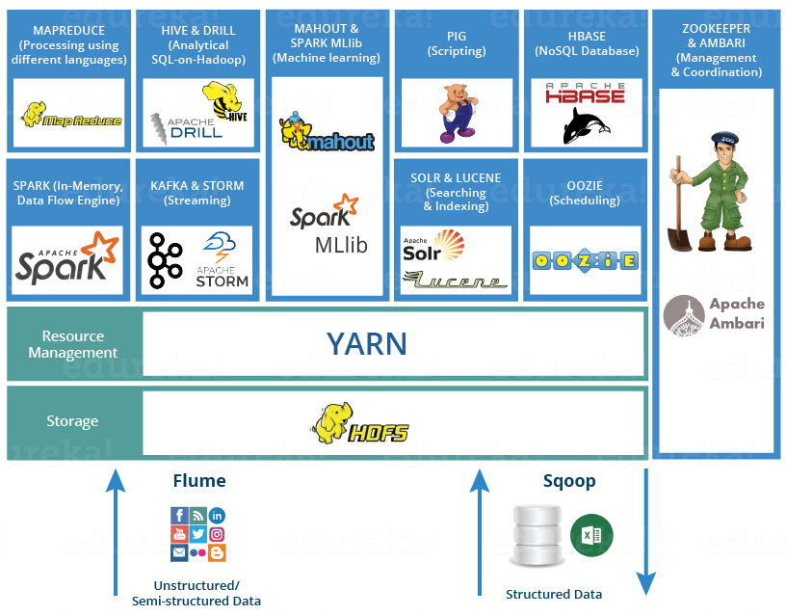
Hadoop Ecosystem

